Slide 1
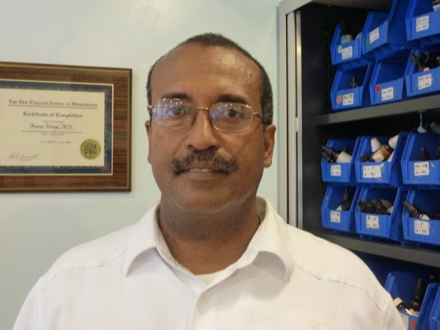
Stem Cell Therapy
Kamau Kokayi, MD
Senior Staff Physician, Patients Medical
Medical Director, New York Stem Cell Treatment Center
Family Practice, Holistic and Chinese Medicine

Slide 2


Patients Medical
A holistic medical center
Full-service

Slide 3

Patients Medical
Discover health, rediscover vitality
Focus on the root cause
Integrate modern medicine, holistic practices, and natural supplements

Slide 4

Patients Medical
Our goal
  Promote healing and prevent disease

Slide 5

Patients Medical
Physicians collaborate to approach each patient holistically.

Slide 6

Patients Medical
Result:
Gain health and nutritional wisdom that can be applied for years to come.

Slide 7
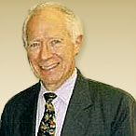
Patients Medical
Founder, Dr. Warren Levin
began practicing his ground-breaking holistic protocols in 1974.

Slide 8

Patients Medical
Conditions Treated
  Chronic Fatigue Syndrome
  Multiple Sclerosis
  Osteoarthritis (OA)
  Rheumatoid Arthritis (RA)
  Diabetes
  Heart disease
  Crohn’s disease, IBS, IBD
  Alzheimer’s disease
  Lyme disease
  Thyroid disease
  Auto-immune diseases
  Many other secondary medical conditions

Slide 9

Patients Medical
Staff
  Medical Doctors
    Internal Medicine
    Family Practice
    Gynecology
    Oncology and Hematology
    Immunology
    Alternative Pain Management
    Pediatrics
  Nutrition
  Kinesiology
  Cranio-Sacral Therapy
  Reiki and Reflexology
  Oriental Medicine and Acupuncture
  Homeopathy

Slide 10

Patients Medical
Integrative Medicine

Slide 11
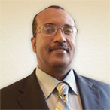
Patients Medical
This evening’s speaker:
Kamau Kokayi, MD
Family Medicine, Chinese and Holistic Medicine
Medical Director, New York Stem Cell Treatment Center
Senior Staff Physician, Patients Medical

Slide 12

Patients Medical
Received medical doctorate from Yale
Completed residency with board certification in Family Medicine
Certified in acupuncture, Chinese herbal medicine, applied kinesiology (AK), and homeopathy
25 years’ experience in integrative medicine

Slide 13

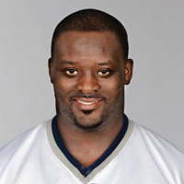


Stem Cell Therapy in the News
Broncos Quarterback, Peyton Manning
NE Patriots Lineman, Jarvis Green
Texas Governor, Rick Perry
Actor and Author, Suzanne Somers

Slide 14
Stem Cell Therapy

Slide 15
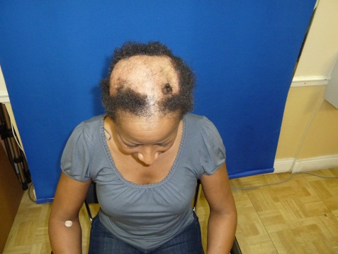
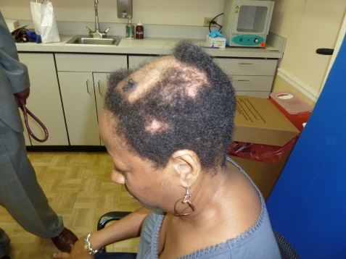
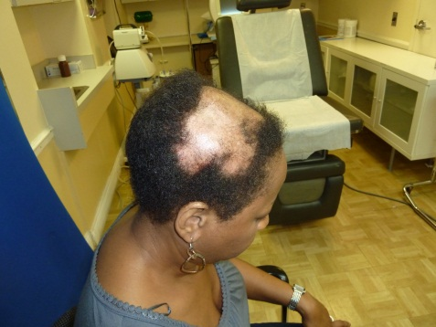
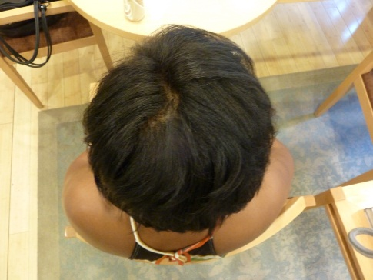

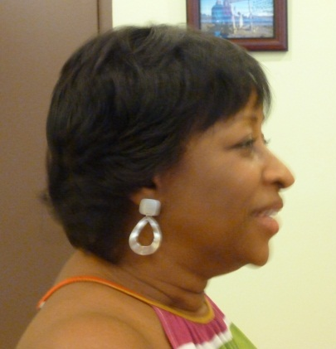
Stem Cell Case Study:
Hair Regrowth for Alopecia
Before
After

Slide 16
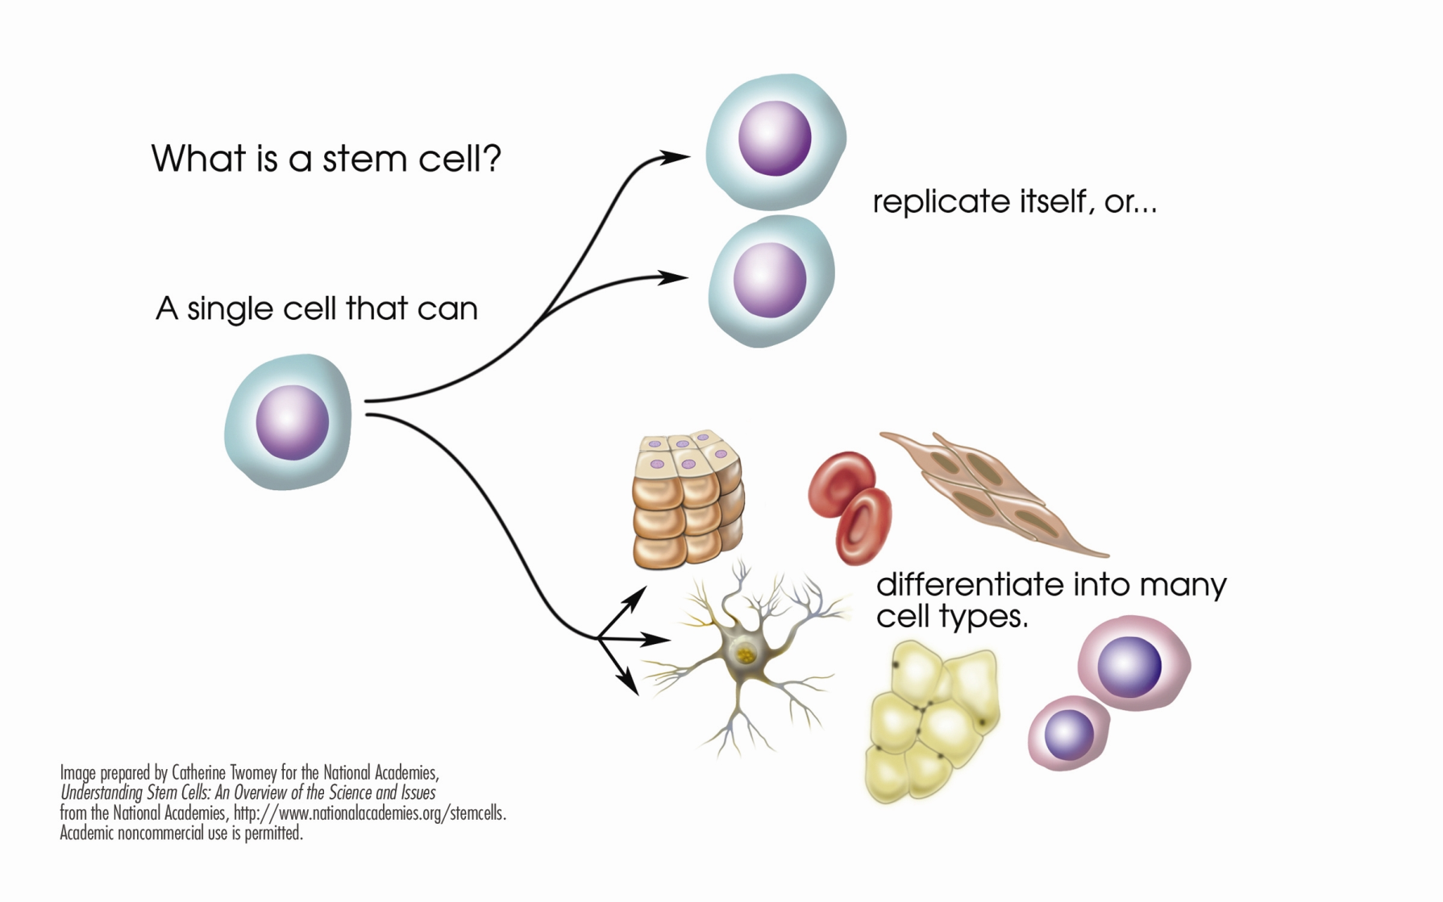
What is a stem cell?

Slide 17
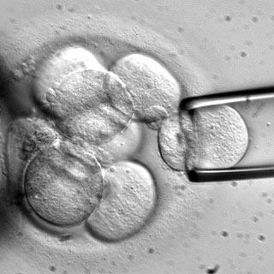
What are Stem Cells?
Have potential to develop into many different cell types in the body
Internal repair system: a blueprint
capable of taking on structure and
function found throughout the body’s
tissues
When a stem cell divides, each new cell has the potential to
  Remain a stem cell or…
  Become another type of cell with a more specialized function (i.e. muscle cell, red blood cell, brain cell, etc)

Slide 18

What are Stem Cells?
Offer new possibilities
  Treating chronic conditions
  Regenerative and reparative medicine

Slide 19
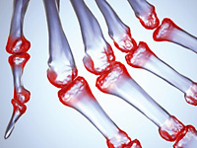
What is regenerative medicine?
Regenerative cell functions include
  Anti-inflammatory
  Immuno-Modulation
  (affecting the immune system)
  Trophic Support (energy level)
  Differentiation (how a cell specializes)
  Homing (knowing where to migrate)
  Revascularization (increasing blood flow)
  Maximizing cell longevity with efficient removal
  and processing of dead cells

Slide 20

History of Stem Cell Therapy
Prior to 2009 patients were going to Dominican Republic, Costa Rica, Panama, Mexico and China as well as other countries in Asia to receive stem cell therapy.

Slide 21
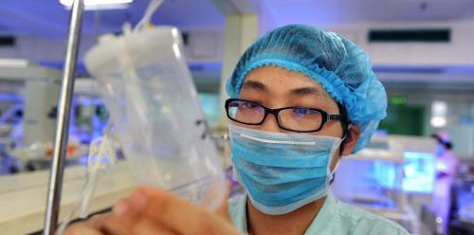
History of Stem Cell Therapy
US slowly getting caught up to other countries where stem cell therapy has been used more regularly, particularly in China.

Slide 22

History of Stem Cell Therapy
Clinical trials are being started throughout the country to
Explore the clinical applications
Minimal liability associated with
adipose stem cells
Promising results in various
animal experiments

Slide 23

Are Stem Cells Safe?
“Cells removed from a patient and replaced during the same surgical procedure pose no greater risk of disease transmission than the surgery itself.”
- FDA Regulation of Stem-Cell-Based Therapies,
Halme and Kessler, New England Journal of
Medicine, 2006

Slide 24
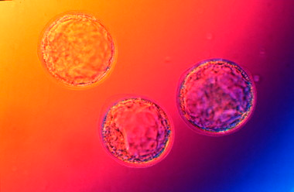
FDA-Exempt from regulation if…
Autologous cells for homologous use
Same setting surgery
Minimal manipulation of cells
Don’t promote therapeutic results

Slide 25

Study #1 – IRB Approved
Primary Objective: Evaluation of Adverse Events Related to Deployment of SVF
Secondary Objective: Evaluation of Conditions Treated

Slide 26
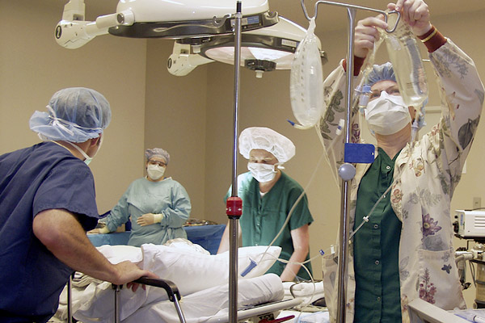
Stem Cell Clinical Trials
Institutional Review
Board (IRB)
approved protocol
SVF deployment on
an investigational basis
Multidisciplinary team to evaluate patients with a variety of conditions often responsive to cell therapy
Nation-wide investigation

Slide 27

What conditions may benefit from Stem Cell Therapy?
Low vitality/energy
Osteoarthritis
Auto-Immune Diseases (Rheumatoid Arthritis, Lupus, etc)
Congestive Heart Failure
Type 2 Diabetes
Kidney Disease
Multiple Sclerosis
Crohn’s disease, IBD/IBS
Early stages of Alzheimer’s
Nagging/chronic aches/pain in joints
Neurological issues
Chronic fatigue
Hair regeneration for men and women
Gum regeneration
Cartilage regeneration – orthopedics
Wound healing

Slide 28
Current Stem Cell Breakthroughs
1) University of Minnesota, Dr Taylor et al: using stem cells to build a complete heart ie. No transplant necessary…completed with rats in 2008….work on human heart in progress
2) Cedars-Sinai Heart Institute in Los Angeles, Professor Eduardo Marban: A pinch of tissue taken from the heart by catherization are then expanded in a culture medium to the point where there are clusters of cells that are actually beating…these are reinjected into the heart and in their latest work with heart attack victims 50% of the scarring was transformed into normal cardiac tissue
3) China, Dr Xiao: Scientists have given cells from adult pigs the ability to turn into any tissue in the body, just like embryonic stem cells. Pig organs closely resemble human organs and work is underway to make the pig organs compatible with the human immune system. Long term scenario of pigs not being grown for bacon or ham but for their organs!

Slide 29
Current Stem Cell Breakthroughs
4) Italy, from the Family Research Council Blog: Italian scientists report that they have restored sight to patients blinded by chemical burns using the patient’s own adult stem cells. The team treated 112 patients blinded in one or both eyes; some of whom had been blind for years. Adult stem cells were taken from the edge of a patient’s eye and cultured on fibrin, then the cell layers transplanted onto the damaged eyes. The adult stem cells produced healthy corneas and functioning eyes. Some patients regained sight within two months, while for others with deeper injuries the process took a year before vision was restored. Patients were followed up to ten years after the transplant. After a single transplant, 69% of patients regained vision; in some cases a second transplant occurred, with a total success in 77% of patients and partial vision restoration in 13% of patients.

Slide 30
Current Stem Cell Breakthroughs
5) London and Harvard: An artificial scaffold of plastic, modeled after a man’s esophagus , was put in a shoe box sized bioreactor where it was turned over and over like a rotisserie chicken with the seasoning being the man’s stem cells from his bone marrow which were dripped onto the scaffold for two days. Chemicals were use to induce transformation of cells into cartilage and other tissues of the esophagus. Within two days the new esophagus was functioning like normal tissue without any immune system rejection.
6) Nature Cell Biology: Even older females retain adult stem cells that can stimulate fertility, including the production of more eggs.

Slide 31
Current Stem Cell Breakthroughs
7) Journal of the American Medical Association: 20 of 23 patients became insulin-independent after treatment with their own bone marrow adult stem cells. Some of the patients have gone for four years insulin-free.
8) Brazil, Dr Richard K Burt: Type 1 diabetics have their immune cells attacking the pancreas destroyed with chemo and then replaced by stem cells from their own blood. Patients have remained insulin free for as long as four years

Slide 32
Current Stem Cell Breakthroughs
9) Dr. Jeremy Mao, the Edward V. Zegarelli Professor of Dental Medicine at Columbia University Medical Center: Unveiled a growth factor-infused, three-dimensional scaffold with the potential to regenerate an anatomically correct tooth in just nine weeks from implantation. By using a procedure developed in the university's Tissue Engineering and Regenerative Medicine Laboratory, Dr. Mao can direct the body's own stem cells toward the scaffold, which is made of natural materials. Once the stem cells have colonized the scaffold, a tooth can grow in the socket and then merge with the surrounding tissue.

Slide 33
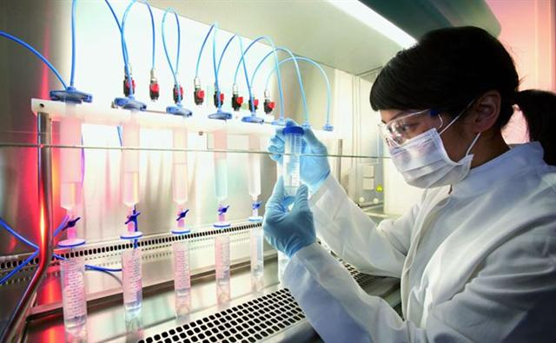
How do you harvest stem cells from fat cells?
The fat from the mini-liposuction is processed using a combination of centrifuge, collagenase, and incubation
Cells are filtered and counted
The cells are injected into a saline IV bag for use

Slide 34
What is Stromal Vascular Fraction (SVF)?
These are the cells that have been separated from the adipose (fat) cells and processed out
Cellular composition of the SVF ranges
  Adult stem cells
  Pre-adipocytes (fat cells)
  Endothelial cells (thin layer of cells that lines the interior surface of blood vessels)
  Smooth muscle cells (muscle fibers)
  Pericytes (connective tissue)
  Fibroblasts (connective tissue, collagen, wound healing)
  Growth factors (naturally occurring substance capable of stimulating cell growth)

Slide 35
How do the cells know where to go?
Homing is an important function
  Mechanism by which a cell migrates from one area of the body to a distant site where it may be needed for a given physiological event
  Important function that permits cells to effectively target a specific area of pathology

Slide 36
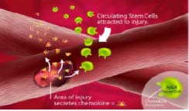
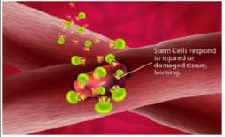
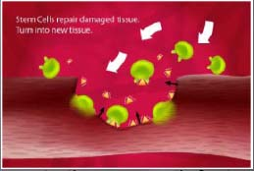
How do the stem cells work?
1. Injury secretes chemokines
2. Stem cells attracted to chemokines
3. Stem cells secrete tissue growth
factor, turn into new tissue

Slide 37
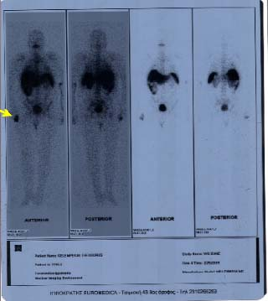
Clinical Evidence
FDA-Approved 99mTC Radio Tagging
99mTC-HMPAO labeled ADSCx administered to hand by IV

Slide 38
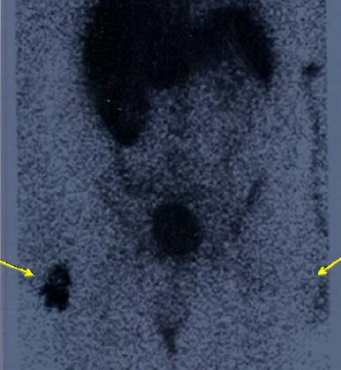
Clinical Evidence
Stem cells home on arthritic hand
No stem cells in
other hand
Dark area: stem cells that were tagged

Slide 39
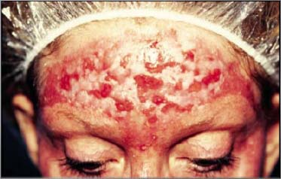
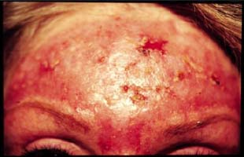
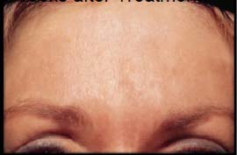
Treatment for Burn Scarring
6-month non-healing wound from laser treatment
6 weeks after treatment
8 weeks after treatment

Slide 40
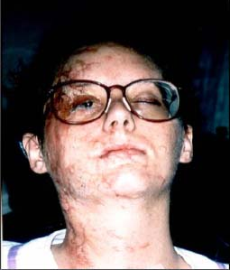
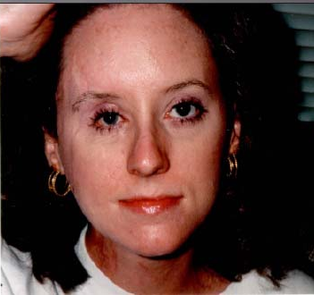
Treatment for Burn Scarring
Before
After

Slide 41
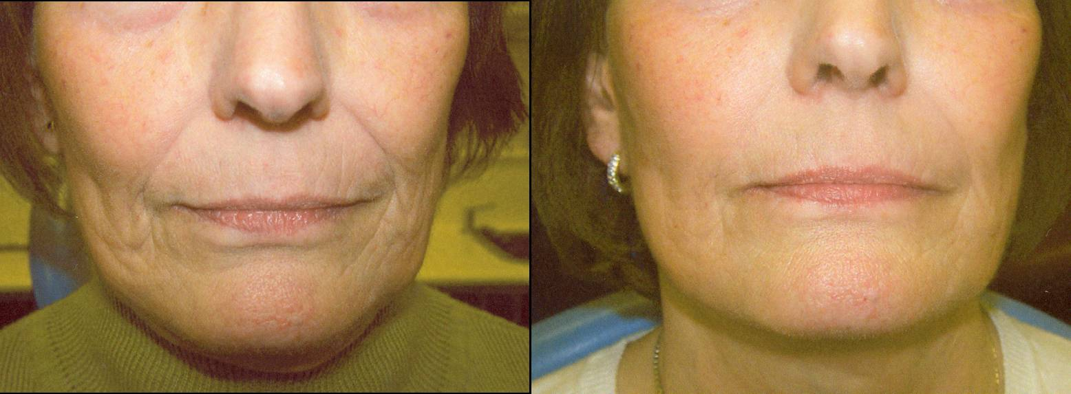
Treatment for Aesthetics
70 year old woman
Before
After

Slide 42
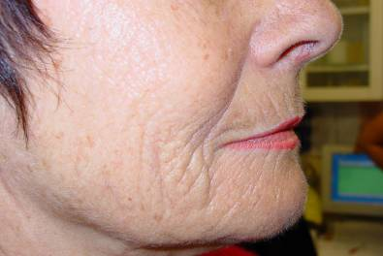
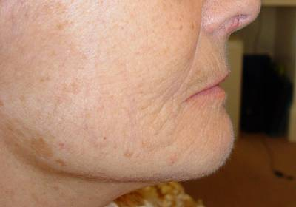
Treatment for Aesthetics
Before
After

Slide 43
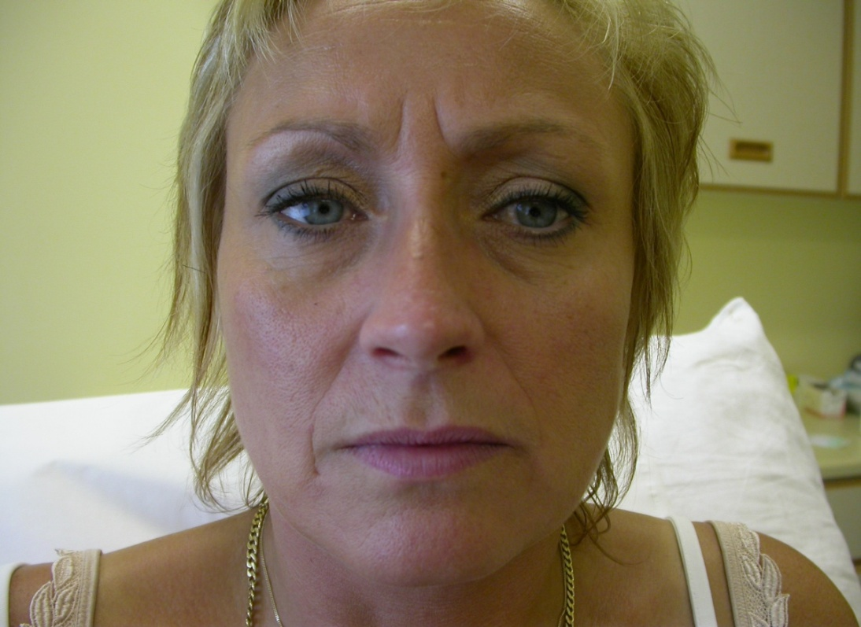
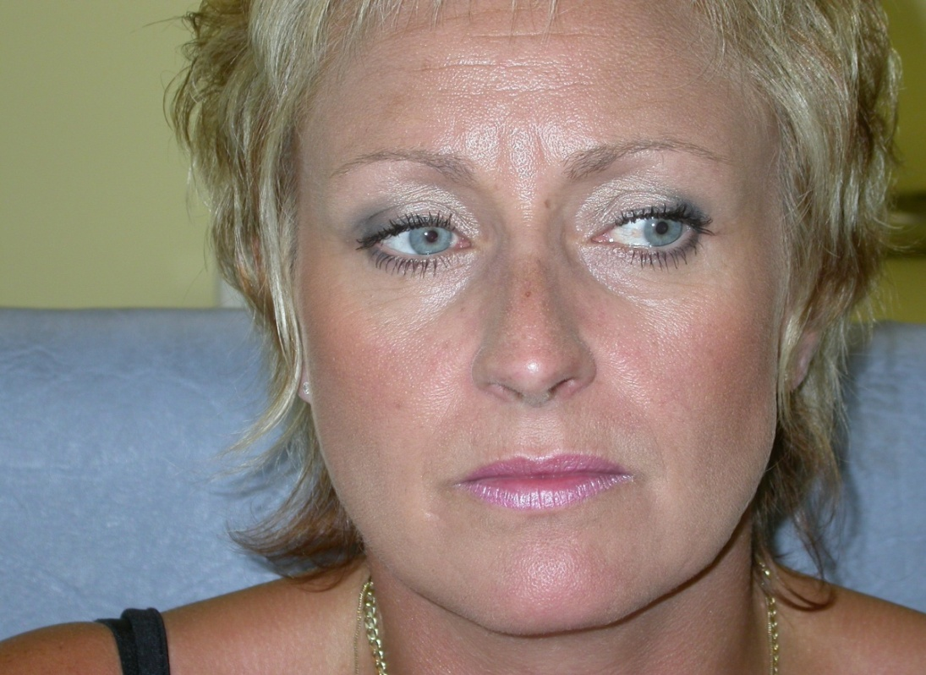
Treatment for Aesthetics
Before
After

Slide 44
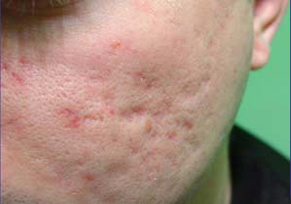
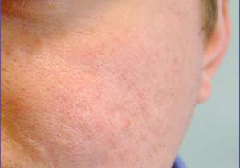
Treatment for Acne Scarring
Before
After

Slide 45
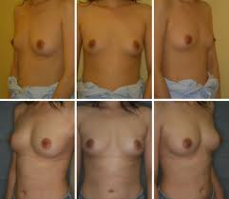
Treatment for Breast Augmentation
Before
After

Slide 46
Urology Research
Adult Stem Cell Therapy For Erectile Dysfunction
ORLANDO, FL (UroToday.com) - Dr. Tom Lue discussed autologous stem cell use for ED. He discussed that ability for the planarian species to regenerate any part of its body, but the salamander can only regenerate a limb. In man there are also stem cells, which are undifferentiated cells that have potential to also regenerate.
In adipose tissue there are stem cells as demonstrated by immunohistochemistry, RT-PCR and Western blotting experiments. The adipose derived stem cells (ADSCs) reside near small blood vessels. CD34 staining identifies 60% of peri-vascular areas as harboring ADSCs. It occurs in new blood vessels, and is a sign of regeneration. ADSCs can be harvested by liposuction or fat excision. Adipose cells are digested and ADSCs are cultured for further induction, labeling or gene transfection. ADSCs can also be used for in vivo tissue engineering.
In vitro induction can result in hepatocytes, beta cells to produce insulin or endothelial cells. In vivo, ADSCs placed in muscle can differentiate into skeletal muscle, placed near blood vessels become smooth muscle and in fat can become fat cells. The differentiate into component cell types and integrate into the tissue. Four weeks after injection of ADSCs following cavernous nerve crush injury in a rat model, there is return of function. In older men, he proposed using autologous ADSCs to regenerate erectile function. In rats there is suggestion of differentiation. In a type 2 diabetic rat model of ED, use of ADSCs resulted in improved intracavernosal pressures. He showed neurite cell growth in vitro, that is stimulated by the addition of ADSCs. Experiments using ADSCs to stimulate endothelial cell growth also suggested that this is possible.
A study showed injection of umbilical cord blood stem cells into men having failed PDE5 inhibitors resulted in improved erectile function. This is only a pilot experiment, but shows great promise.
Presented by Tom F. Lue, MD, at the Annual Meeting of the American Urological Association (AUA) - May 17 - 22, 2008. Orange County Convention Center - Orlando, Florida, USA.
Reported by UroToday.com Contributing Editor Christopher P. Evans, MD, FACS

Slide 47
Urology Research
Peyronies Disease
Peyronies Disease has been described by experts as a physically and psychologically devastating problem manifested by a fibrous inelastic scar of the fibrous chambers of the penis known as the tunica albuginea. The scarring (known as “peyronies plaques”) can cause pain, bending, narrowing, hinging and shortening of the penis in the erect state. Recent demographic studies have shown that up to 9% of men have this problem and it seems to be even more prevalent after radical prostatectomy surgery. More than half of the cases worsen over time and only 13% resolve spontaneously. Peyronies is also closely associated with erectile dysfunction.
There is no known non-surgical cure for PD and surgery can often result in more scarring, shortening or loss of sensation and adequate erectile function. Cases that involve calcification seem to do the worst with non-surgical treatment. Non-surgical therapies include: Vitamin E, Potaba, colchicine, tamoxifen, carnitine, and Omega-3 fatty acids. Unfortunately, formal studies have shown no benefit of any of these over placebo. Verapamil cream is often used by clinicians but there are no controlled trials proving that the verapamil penetrates into the tunica albuginea. There have been eight studies on intralesional injection of verapamil showing some positive effects in decreasing curvature and deformity improved in 30% to 60% of patients. The usual treatment is 10 mg injected every two weeks a total of twelve times. Injection of interferon alpha 2b has shown very mixed results. There is an ongoing FDA study of a drug (phase 3) called Xiaflex which is made from bacterial collagenase. Early results may be promising with curvature reduction 20% higher than with placebo. There are some ongoing European studies of a penile traction device that stretches the penis and early results seem to indicate a benefit but it involves a rigorous daily application of a device to the penis.
There is evidence that stem cells will actively seek out and attempt to repair a Dupytren’s contracture which is nearly identical to PD but occurs in the hand. Stem cells may be highly effective in inflammatory scarring conditions occurring in other parts of the body. We have developed a protocol for intralesional injection of autologous stem cells into peyronies plaques as a non-surgical option for patients who have not responded to other conservative measures but wish to avoid surgery.

Slide 48
Urology Research
Erectile Dysfunction
Erectile Dysfunction is defined as the inability to achieve or sustain an erection suitable for sexual intercourse. ED affects up to one third of men of men throughout their lives and has a substantial negative impact on intimate relationships, quality of life and self-esteem. Causes are multifactorial but can be related to loss of testosterone, surgical damage to the penile nerves, medications, or other medical illnesses. The most common cause of ED is “vasculopathy”, which is damage to the delicate blood vessels in the penis. This vasculopathy is often associated with age but strongly related to atherosclerosis, diabetes, hypertension, high cholesterol and cerebrovascular and peripheral vascular disease. Men with ED are also at significantly increased risk of coronary artery disease. Therefore, when men have ED, screening for cardiovascular risk factors should be considered because symptoms of ED present as much as three years earlier than other symptoms of coronary artery disease such as chest pain.
The current treatment of ED centers around the use of Phosphodiesterase type 5 inhibitors such as Viagra, Cialis, or Levitra. Intraurethral pellets and intracavernosal (penile injectable agents) are also available if oral medications fail. Various mechanical external vacuum pump devices are helpful also in patients who are comfortable with assisted devices. Penile revascularization surgery has mostly fallen out of favor due to poor outcomes in most patients. At this time, the only treatment available to patients who have not succeeded with any of the above are surgically implanted hydraulic penile prostheses. These surgeries are somewhat invasive but mostly effective.
Adipose derived stem cells have shown extraordinary promise in revascularizing cardiac tissue, ischemic limbs and other organs suffering damage from poor blood flow by regenerating small blood vessels as well as smooth muscle and nerves. We have evidence that adipose derived stem cells stimulate endothelial (small blood vessel lining) growth and improve penile blood flow in animal models. Early attempts have been made in human patients to re-vascularize their penile arteries using stem cells from umbilical cord blood and results showed great promise as discussed at a 2008 meeting of the American Urological Association in Orlando Florida. At California Stem Cell Treatment Center, we have a protocol to deploy extremely high numbers of adipose derived stem cells into the penile corpora cavernosa to naturally revascularize the penis allowing recovery of normal erections.

Slide 49
Urology Research
Male Incontinence
Post prostatectomy incontinence Protocol
In America alone, more than three million men are affected by loss of bladder control, a medical condition known as urinary incontinence. This problem has a great impact on health and quality of life for those who suffer with it. Male urinary incontinence is usually caused by a damaged sphincter, the circular muscle that controls the flow of urine out of the bladder. It often happens as the unavoidable result of prostate cancer surgery. When the sphincter is damaged, the man cannot squeeze or close off the urethra and leakage occurs especially with straining or exercise.
CSCTC is using Stromal Vascular Fraction with adipose derived adult mesenchymal stem cells to treat post prostatectomy incontinence. The SVF and a small amount of condensed fat matrix is injected with a telescope directly into a deficient sphincter under local anesthetic. Based on experience from Nagoya University, Japan where Stromal Vascular Fraction has been used successfully for male incontinence, we believe that the external sphincter may be regenerated to some extent to provide bladder control. CSCTC can provide access to the same technology here in California through our investigational protocol.

Slide 50
Cardiology Research
First Experience in Humans Using Adipose Tissue–Derived Regenerative Cells in the Treatment of Patients With ST-Segment Elevation Myocardial Infarction
Jaco H. Houtgraaf, MD; Wijnand K. den Dekker, MD; et al.
MIBI-SPECT analysis demonstrated a +4% improvement in global LVEF in ADRC-treated patients from 52.1% to 56.1%, whereas the placebo group deteriorated by −1.7% (52.0% to 50.3%), rendering an absolute difference between the treatment groups of +5.7% (p = 0.114). A similar positive trend of improved cardiac function was found by CMR analysis, which demonstrated a +4.6% improvement of global LVEF in the ADRC-treated group from baseline to 6-month follow-up (p = 0.091). The percentage of the left ventricle infarcted was reduced by −52% (31.6 ± 5.3 % to 15.3 ± 2.6% at 6-month follow-up, p = 0.002; Figure 1A) in the ADRC-treated patients, as opposed to no change in the placebo-treated AMI patients (24.7 ± 9.2 % vs. 24.7 ± 4.1%; p = 0.48 for difference between groups). In addition, in the placebo group, the perfusion defect deteriorated by +1.8% (15.0 ± 4.9% to 16.8 ± 4.3%) compared with a significant improvement of the perfusion defect in ADRC-treated patients from 16.9 ± 2.1% to 10.9 ± 2.4% at 6-month follow-up (change of −6.0%, p = 0.004; Figure 1B; p = 0.23 for difference between groups).
The main findings of the APOLLO trial at the 6-month clinical and angiographic follow-up time point are 1) liposuction to harvest ADRCs in the acute phase of an AMI is safe and feasible; 2) intracoronary infusion of freshly isolated ADRCs was safe and did not result in an alteration of coronary flow or any indication of microvascular obstruction; 3) no SAEs were related to the ADRC therapy; and 4) ADRC infusion resulted in a trend toward improved cardiac function, accompanied by a significant improvement of the perfusion defect and a 50% reduction of myocardial scar formation. The latter is consistent with findings in preclinical studies and concordant with the presumed proangiogenic, antiapoptotic, and immunomodulatory working mechanism of ADRC therapy.

Slide 51
Cardiology Research
Effect on left ventricular function of intracoronary transplantation of autologous bone marrow mesenchymal stem cell in patients with acute myocardial infarction
Shao-liang Chen, MD, Wu-wang Fang, MD, Fei Ye, MD, et al.
Sixty-nine patients who underwent primary percutaneous coronary intervention within 12 hours after onset of acute myocardial infarction were randomized to receive intracoronary injection of autologous bone marrow mesenchymal stem cell or standard saline. Several imagining techniques demonstrated that bone marrow mesenchymal stem cells significantly improved left ventricular function. 2004 by Excerpta Medica, Inc.
(Am J Cardiol 2004;94:92–95)

Slide 52
Cardiology Research
Stem cells and COPD
Expert Opin Biol Ther. 2010 May;10(5):681-7.
Mesenchymal stem cell therapy for the treatment of chronic obstructive pulmonary disease.
D’Agostino B, Sullo N, Siniscalco D, De Angelis A, Rossi F.
Source
Department of Experimental Medicine, Second University of Naples, Section of Pharmacology L Donatelli, via S Maria di Costantinopoli, 16-80138 Napoli, Italy.
Abstract
Recent studies have revealed that adult stem cells such as bone marrow-derived cells contribute to lung tissue regeneration and protection, and thus administration of exogenous stem/progenitor cells may be a potent next-generation therapy for COPD. Pathogenesis of COPD is characterized by an upregulation of inflammatory processes leading to irreversible events such as apoptosis of epithelial cells, proteolysis of the terminal air-space and lung extracellular matrix components. The available pharmacological treatments are essentially symptomatic, therefore, there is a need to develop more effective therapeutic strategies. It has been previously demonstrated that transplanted MSC home to the lung in response to lung injury and adopt phenotypes of alveolar epithelial cells, endothelial cells, fibroblasts and bronchial epithelial cells. However, engraftment and differentiation are now felt to be rare occurrences and other mechanisms might be involved and play a more important role. Importantly, MSCs protect lung tissue through suppression of proinflammatory cytokines, and through triggering production of reparative growth factors. Accordingly, it is not clear if and how these cells will be able to repair, to slow or to prevent the disease. This article reviews recent advances in regenerative medicine in COPD and highlights that their potential application although promising and very attractive, are still a far away opinion.

Slide 53
Cardiology Research
Stem Cells and Asthma
Curr Stem Cell Res Ther. 2010 Jun;5(2):111-5.
Immunomodulatory effects of adipose-derived stem cells in airway allergic diseases.
Cho KS, Roh HJ.
Source
Department of ORL-HNS and Medical Research Institute, Pusan National University School of Medicine, Busan, South Korea.
Abstract
Allergic rhinitis and asthma are inflammatory airway allergic diseases caused by Th2-driven immune response. Several studies have shown that multipotent adipose-derived stem cells (ASCs) can exert profound immunosuppressive effects via modulation of both cellular and innate immune pathway, especially immunosuppressive effect on T cell activities. ASCs’ ability to be readily isolated from a number of adipose tissues and expanded ex vivo makes them attractive candidate for use in clinical therapy in the context of allogeneic transplantation, in particular to modulate graft-versus-host disease and graft rejection. The authors have investigated whether ASCs can inhibit Th2-dependent airway allergic disease in the mouse model. In this article we review recent experimental data and discuss about the mechanisms by which ASCs inhibit allergic airway inflammation via immunomodulation from a Th2 to a Th1-biased response in the mouse model.
PMID: 19941459

Slide 54
Orthopedics Research
Report: McClain receives stem cell therapy
April 23, 2012
Paul Gutierrez, CSNBayarea.com
Maybe this is why Rolando McClain has looked a step slow and late pursuing the ball -- the Raiders middle linebacker has been playing with pain in both knees in his career and endured a high ankle sprain last season.
Without making excuses for the No. 8 overall pick of the 2010 draft, McClain was so beat up and frustrated he's turned to an experimental stem cell therapy to ease the pain and expedite the healing. According to the Mobile Press Register, radiologist Jason R. Williams liposuctioned fat cells from a part of McClain's body and injected them into his knee and ankle.
Voila?
"It feels a lot better," McClain told the newspaper, "with hardly any pain at all."
He apparently has been working out during the team's voluntary mini-camp.
Said Williams: "This is going to be the future of medicine."

Slide 55
Orthopedics Research
Promising stem cell therapy may prevent osteoarthritis after joint injury
Duke researchers may have found a promising stem cell therapy for preventing osteoarthritis after a joint injury.
Injuring a joint greatly raises the odds of getting a form of osteoarthritis called post-traumatic arthritis, or PTA. There are no therapies yet that modify or slow the progression of arthritis after injury.
Researchers at Duke University Health System have found a very promising therapeutic approach to PTA using a type of stem cell, called mesenchymal stem cells (MSCs), in mice with fractures that typically would lead to them developing arthritis. Their findings could lead to a therapy that would be used after joint injury and before signs of significant osteoarthritis.
The scientists thought the stem cells would work to prevent PTA by altering the balance of inflammation and regeneration in knee joints, because these stem cells have beneficial properties in other regions of the body.
"The stem cells were able to prevent post-traumatic arthritis," said Farshid Guilak, Ph.D., director of orthopaedic research at Duke and senior author of the study.
The study was published on August 10 in Cell Transplantation.
The researchers also thought that a type of mice bred for their super-healing properties would probably fare better than typical mice, but they were wrong.
"We decided to investigate two therapies for the study, said lead author Brian Diekman, Ph.D., a postdoctoral researcher in the Guilak lab. "We thought that stem cells from so-called superhealer mice would be superior at providing protection, and instead, we found that they were no better than stem cells from typical mice. We thought that maybe it would take stem cells from superhealers to gain an effect as strong as preventing arthritis after a fracture, but we were surprised - and excited - to learn that regular stem cells work just as well."

Slide 56
Orthopedics Case Study
Knee Surgery and Knee Replacement Alternative
Jarvis Green gets Contract with Houston Texans, Attributes it to Regenexx Stem Cell Injections
Jarvis was a 2 time super bowl champion defensive lineman (previously with the New England Patriots from 2002-2009 and a free agent with the Broncos in 2010) who had failed lateral meniscus surgery on his knee. As a result of his failed knee surgery, he missed three games and was cut by the Broncos this year. Jarvis had the procedures to try to get him back to playing football. We are proud to report today that he was signed today by the Houston Texans, passed a team physician physical, and states that he was able to try out in full form without limitations. He attributes his ability to get back to playing to the procedures. Go Jarvis!
“I’m happy to report that my knee is doing GREAT. Before the procedure, my knee felt completely unstable…Now I’m able to do just about anything without any pain at all. I’m absolutely thrilled with the results I’ve experienced.” GK
“It is now 11 weeks since my second Regenexx-SD treatment and I am pain free in my knee. I walk 6-7 miles playing golf, carrying my clubs, four times each week. This has been an amazing recovery. Thanks.” MW

Slide 57
Rheumatology Case Study
Check out these quotes:
Michael Foster – “I got my life back.”
Bryan Gamez – “I could see myself in a wheelchair if I had not received this treatment. I think it saved my life.”
Darnell Morris – “I could raise both arms over my head. I have not been able to do this in two years. I also have experienced a feeling of relief in my body. I think this is because the pain level is so much lower after my treatment.”
Kathleen Flores – “Since the treatment I have no pain; I feel really healthy and now I workout 3 times per week and I`m in better shape than I have been in years.”

Slide 58
Rheumatology Research
Patient Enrollment in Phase Iia Rheumatoid Arthritis Study Completed: TiGenix
Leuven, Belgium
Friday, August 10, 2012
TiGenix completed patient enrollment in phase IIa study of Cx611, a suspension of expanded allogeneic adult stem cells, in rheumatoid arthritis. The phase IIa clinical trial is a 53-subject, multicentre, placebo-controlled study in 3 cohorts with different dosing regimens, designed to assess safety, feasibility, tolerance, and optimal dosing. The study is being conducted at 23 centres.
The company believes that this clinical trial can set the stage not only for the further development of Cx611 in RA, but also in a wide range of other autoimmune disorders.
“In addition to the primary endpoints of safety and optimal dosing, we expect this trial to yield a first indication of the duration of the efficacy of Cx611 in this very difficult patient population: the enrolled patients have previously failed to respond to at least two biologicals,” said Eduardo Bravo, CEO of TiGenix. “In the trial patients are treated with three injections of Cx611. The six-month follow-up without further dosing should provide us with a truly meaningful result. This is the most advanced stem cell therapy trial in RA in the world, and completing the enrollment on time confirms our leadership position in the field. We anticipate reporting the results of the study no later than April 2013.”
Cx611 is a suspension of expanded allogeneic adult stem cells derived from human adipose (fat) tissue (expanded Adipose derived Stem Cells or ‘eASCs’) that is delivered through intra-venous injection for the treatment of rheumatoid arthritis. The objective of the phase IIa trial is to determine safety, feasibility, tolerance, and optimal dosing. This multicentre, placebo-controlled study has enrolled 53 patients, divided in 3 cohorts with different dosing regimens. There are 23 centers open and the company expects the final results to be available in the first half of 2013.
TiGenix NV is a leading European cell therapy company with a marketed product for cartilage repair, ChondroCelect, and a strong pipeline with clinical stage allogeneic adult stem cell programmes for the treatment of autoimmune and inflammatory diseases.

Slide 59
Rheumatology Research
Adult stem cell transplantation in autoimmune disease
2009 Jul;16(4):285-91 Adult stem cell transplantation in autoimmune disease.
Tyndall A, Gratwohl A
PURPOSE OF REVIEW: This review presents the recent results of a decade’s experience with hematopoietic stem cell transplantation for treating severe autoimmune disease, with special reference to new insights into pathophysiology. In addition, the newly evolving field of mesenchymal stem cell therapy of autoimmune disease is introduced.
RECENT FINDINGS: Phase I/II studies in several major autoimmune disease have shown a satisfactory benefit risk ratio. Over one-third of patients achieve a durable remission with a treatment-related mortality of around 5%. Treatment-related mortality is less for some diseases (2% for multiple sclerosis). Phase III randomized controlled trials are advanced in systemic sclerosis, multiple sclerosis and Crohn’s disease. In systemic sclerosis, data of the past 12 months suggest remodeling of collagen and normalization of microvasculature after hematopoietic stem cell transplantation, a new finding. Mesenchymal stem cells have shown promise in exerting an immediate anti inflammatory immunomodulatory role in some autoimmune disease with little evidence of acute toxicity.
SUMMARY: Hematopoietic stem cell transplantation for severe autoimmune disease has been shown to be feasible, and definitive phase III randomized trials are now in progress. Durable remission after immune reconstitution and tissue remodeling suggests an effect beyond profound immunosuppression. Mesenchymal stem cells show promise as immunomodulatory agents in autoimmune disease with low acute toxicity and no requirement for ablation of the recipient immune system.
PMID: 19465851 [PubMed - indexed for MEDLINE]

Slide 60
Rheumatology Research
Application to bone and cartilage repair.
Expert Opin Biol Ther. 2008 Mar; 8(3) : 255-68. Role of mesenchymal stem cells in regenerative medicine: application to bone and cartilage repair.
Granero-Molto F, Weis JA, Longobardi L, Spagnoli A.
University of North Carolina at Chapel Hill, Division of Endocrinology, Department of Pediatrics, 3341 Medical Biomolecular Research Building, 103 Mason Farm Road Campus Box: 7039, Chapel Hill North Carolina 27599-7239, USA.
BACKGROUND: Mesenchymal stem cells (MSC) are multipotent cells with the ability to differentiate into mesenchyme-derived cells including osteoblasts and chondrocytes.
OBJECTIVE: To provide an overview and expert opinion on the in vivo ability of MSC to home into tissues, their regenerative properties and potential applications for cell-based therapies to treat bone and cartilage disorders.
METHODS: Data sources including the PubMed database, abstract booklets and conference proceedings were searched for publications pertinent to MSC and their properties with emphasis on the in vivo studies and clinical use in cartilage and bone regeneration and repair. The search included the most current information possible.
CONCLUSION: MSC can migrate to injured tissues and some of their reparative properties are mediated by paracrine mechanisms including their immunomodulatory actions. MSC possess a critical potential in regenerative medicine for the treatment of skeletal diseases, such as osteoarthritis or fracture healing failure, where treatments are partially effective or palliative.
PMID: 18294098

Slide 61
Gastroenterology Research
Crohn’s Disease Cured By Stem Cell Therapy
Stem cell transplant therapy has successfully cured patients suffering from Crohn’s disease, a terrible disease that afflicts an estimated 600,000 people in North America and millions more worldwide. Success in treating Crohn’s disease is just one of a string of recent success for stem cell and related therapies. The future for tens of millions of people suffering across the globe is looking brighter everyday as an explosion in treatments and cures for disease sees no signs of abating.
Crohn’s disease is an autoimmune disease in which the body’s own immune system attacks the gastrointestinal tract, resulting in a lifetime of severe diarrhea and stomach pain for its sufferers. Severe is an understatement: for the worst sufferers Crohn’s disease can mean 20-30 painful and embarrassing diarrhea visits to the toilet everyday. Treatment is sometimes effective for mild cases of the disease, but for the most severe cases treatment options are very limited. Now with the recent development of a stem cell transplant cure, more than 20 individuals with the most severe form of the disease have seen their symptoms either completely or almost completely eradicated.

Slide 62
Gastroenterology Research
Stem Cell Therapy for Inflammatory Bowel Disease
Prof Dr. DW Hommes, Duijvestein
Hematopoietic stem cell transplantation and mesenchymal stromal (MSC) cell therapy are currently under investigation as novel therapies for inflammatory bowel diseases (IBD). Hematopoietic stem cells are thought to repopulate the immune system and reset the immunological response to luminal antigens. MSCs have the capacity to differentiate into a wide variety of distinct cell lineages and to suppress immune responses in vitro and in vivo. Recent results from animal models and early human experience in graft-versus-host disease (GvHD) and also Crohn's disease (CD) suggest that ex vivo expanded MSCs may have clinically useful immunomodulatory effects. The main goal of this thesis was to study the safety, feasibility, and applicability of stem cell therapy in IBD.

Slide 63
Gastroenterology Research
Use of allogeneic mesenchymal stem cells in the treatment of intestinal inflammatory diseases.
Lazebnik LB, Konopliannikov AG, Kniazev OV, et al., Ter Arkh. 2010;82(2):38-43.
AIM:
to determine the whether mesenchymal stem cells (MSC) may be used in the treatment of patients with chrOnic intestinal inflammatory diseases (IID).
RESULTS:
A statistically significant decrease in the indices of the clinical and morphological activities of an inflammatory process was noted in 39 patients with UC and in 11 patients with CD as compared with the comporison groups after MSC transplantation. Clinicomorphological remission occurred in 40 patients. Inclusion of MSC into the treatment program was ineffective in 8 patients with UC and in 2 patients with CD. The use of MSC made it possible to discontinue corticosteroids in 34 of the 50 patients with the hormone-dependent and hormone-resistant forms of UC and CD and to reduce the dose of prednisolone to 5 mg/day in 7 patients, by administering 5-aminosalicylic acid only.
CONCLUSION:
The use of MSC may be appreciated as a new strategic direction of therapy for IID. The intravenously administered stem cells exert a potent immunomodulatory effect, reduce the activity of autoimmune inflammation, and stimulate a reparative process in the intestinal mucosa.

Slide 64
Neurology Research
www.stemcellresearch.org/stemcellreport/scr-2002-spring.htm
In Humans
Treating Parkinson's with Adult Stems Cell and Other Alternatives
Using adult neural stem cells, Dr. Michel Levesque, at the Cedars-Sinai Medical Center in Los Angeles, reports a total reversal of symptoms in the first Parkinson's patient treated. The patient, a 57-year old former fighter pilot, is still without symptoms three years after the adult neural stem cells were removed from his brain, coaxed into becoming dopamine-producing cells, and then reimplanted. Because the stem cells came from the patient, there was no need for immunosuppression to overcome rejection. "I think transplantation of the patient's own neural stem cells and differentiated dopaminergic neurons is more biologically and physiologically compatible - more efficacious and more elegant," said Levesque. In addition to its use for Parkinson's, the technique is under study for juvenile diabetes, stroke, brain tumors, spinal cord injury, and other conditions.
Results presented April 8th, at the meeting of the American Association of Neurological Surgeons.
Retinal Cell Implants Improve Parkinson's
A team at Emory University School of Medicine has shown that implanting retinal cells into the brains of people with advanced Parkinson's disease can improve motor function by almost half, according to a follow-up study of six patients. The team noted: "We've been following these six participants for over a year, and we've found they've improved, on average, nearly 50 per cent in motor function." The retinal cells used were taken from deceased donors and grown in the lab. The team is not using immunosuppressants.
Result presented April 18 at the annual conference of the American Academy of Neurology in Denver and reported in the New Scientist , April 18, 2002. Note: There are no clinical treatments for Parkinson's based on cloning or embryonic stem cells.

Slide 65
Neurology Research
Stem Cell Therapy Reverses Multiple Sclerosis Damage
Julie Stachowiak, PhD., About.com Guide, Jan 30,2009
In a small (very small) trial, stem cell therapy was found not only to stop the progression of multiple sclerosis, but also to reverse damage. This is the first time research has shown that multiple sclerosis can be reversed, not merely slowed. I am cautiously really, really excited about this.
Here are the basics: In the first step of the therapy, physicians take some of the bone marrow stem cells from your body and keep them alive. Then they use chemotherapy to, essentially, wipe out your immune system. After that, they put the bone marrow stem cells back into your body. The new immune system cells produced (by the stem cells) are "naive" and do not see the myelin as an invader, or something to be attacked. Therefore, they no longer attack the myelin and the body (apparently) can then get to work healing any early-stage multiple sclerosis damage.
This study was done in 23 patients, all with early stage relapsing-remitting (RRMS) multiple sclerosis (they have tried this before in people with later stage disease and it was not successful). After one procedure, these folks were followed for three years. 17 of them improved by at least one point on the disability scale and none of them got any worse (in terms of disability). There is a larger trial now underway to learn more about the risks and benefits of this treatment (especially the risks and at what stage of multiple sclerosis is the treatment most beneficial).

Slide 66
Neurology Research
Autologous mesenchymal stem cells: clinical applications in amyotrophic lateral sclerosis
Letizia Mazzini*, Katia Mareschi, Ivana Ferrero, Elena Vassallo, Giuseppe Oliveri, et al.
Department of Intensive Care, ‘San Giovanni Bosco’ Hospital, Torino, Italy
Objectives: Our study was aimed to evaluate the feasibility and safety of intraspinal cord
implantation of autologous mesenchymal stem cells (MSCs) in a few well-monitored
amyotrophic lateral sclerosis (ALS) patients.
Methods: Seven patients affected by definite ALS were enrolled in the study and two patients
were treated for compassionate use and monitored for at least 3 years. Bone marrow was
collected from the posterior iliac crest according to the standard procedure and MSCs were
expanded ex vivo according to Pittenger’s protocol. The cells were suspended in 2 ml
autologous cerebrospinal fluid and transplanted into the spinal cord by a micrometric pump
injector.
Results: The in vitro expanded MSCs did not show any bacterial o fungal contamination,
hemopoietic cell contamination, chromosomic alterations and early cellular senescence. No
patient manifested major adverse events such as respiratory failure or death. Minor adverse
events were intercostal pain irradiation and leg sensory dysesthesia, both reversible after a mean
period of 6 weeks. No modification of the spinal cord volume or other signs of abnormal cell
proliferation were observed. A significant slowing down of the linear decline of the forced vital
capacity was evident in four patients 36 months after MSCs transplantation.
Conclusions: Our results demonstrate that direct injection of autologous expanded MSCs into the
spinal cord of ALS patients is safe, with no significant acute or late toxicity, and well tolerated.
The clinical results seem to be encouraging. [Neurol Res 2006; 28: 523–526]

Slide 67
Nephrology Research
Mesenchymal stem cells are a rescue approach for recovery of deteriorating kidney function.
El-Ansary M, Saadi G, Abd El-Hamid S.
Source
Department of Clinical Pathology, Kasr El-Aini, Cairo University, Cairo, Egypt Department of Internal medicine & Nephrology, Kasr El-Aini, Cairo University, Cairo, Egypt.
Abstract
Mesenchymal stem cells may provide a new therapeutic tool for the treatment of chronic kidney disease by rescuing deteriorating kidney function. ABSTRACT: Background: Stem cell (SC) therapy for chronic kidney disease (CKD) is urgently needed. The use of mesenchymal stem cells (MSCs) is a possible new therapeutic modality. Our work aimed to isolate human MSCs from adult BM to improve kidney functions in CKD patients. Methods: In our study 30 patients with impaired kidney function were included, their ages ranged from 22 to 68 years. They included 10 inactive glomerulonephritis patients due to systemic lupus erythromatosus (SLE) (group I), 10 renal transplantation cases (group II) and 10 patients of other etiologies as control group. Fifty ml of BM was aspirated from the iliac bone, for separation of MSCs. Results: There was a highly statistically significant difference between both CD271 and CD29 before and after culture with increase of both markers at end of culture, P < 0.01. Finally 50-70 million MSCs in 10 ml saline (0.7-1×10(6 ) MSCs/Kg body weight) were infused intravenously in 2 divided doses 1 week apart. There was a highly statistically significant difference between each of serum creatinine and creatinine clearance levels before and after MSCs injection at 1, 3 and 6 m post infusion period with SLE cases showed a greater decline of their serum creatinine and elevation of mean creatinine clearance levels after injection than transplantation and control groups, P<0.05. Conclusion: MSCs therapy is a potential therapeutic modality for early phases of CKD.

Slide 68
Endocrinology Research
Autologous Nonmyeloablative Hematopoietic Stem Cell Transplantation in Newly Diagnosed Type 1 Diabetes Mellitus
Júlio C. Voltarelli, MD, PhD; Carlos E. B. Couri, MD, PhD; et al.
Results During a 7- to 36-month follow-up (mean 18.8), 14 patients became insulin-free (1 for 35 months, 4 for at least 21 months, 7 for at least 6 months; and 2 with late response were insulin-free for 1 and 5 months, respectively). Among those, 1 patient resumed insulin use 1 year after AHST. At 6 months after AHST, mean total area under the C-peptide response curve was significantly greater than the pretreatment values, and at 12 and 24 months it did not change. Anti–glutamic acid decarboxylase antibody levels decreased after 6 months and stabilized at 12 and 24 months. Serum levels of hemoglobin A_{1c} were maintained at less than 7% in 13 of 14 patients. The only acute severe adverse effect was culture-negative bilateral pneumonia in 1 patient and late endocrine dysfunction (hypothyroidism or hypogonadism) in 2 others. There was no mortality.
Conclusions High-dose immunosuppression and AHST were performed with acceptable toxicity in a small number of patients with newly diagnosed type 1 DM. With AHST, beta cell function was increased in all but 1 patient and induced prolonged insulin independence in the majority of the patients.

Slide 69
Ophthalmology Research
First stem cell treatment in humans improves sight in the blind
A new but tiny study, the first of embryonic stem cell treatment in humans, shows that they may hold promise for the treatment of eye diseases such as macular degeneration, a leading cause of blindness in the elderly.
The experiment
Two legally blind women — one suffering from macular degeneration, the other from Stargardt’s macular dystrophy, which can occur in middle age — each received an implantation of 50,000 stem cells under the retina of one eye last July. They also received drugs to suppress their immune systems to keep the cells from being rejected.
Both patients reported improvements in sight. According to the New York Times,
One said she could see colors better and was able to thread a needle and sew on a button for the first time in years. The other said she was able to navigate a shopping mall by herself.
One of them was also able to several letters on an eye chart when she had previously been able to read none.
The experiment so far appears to have had no adverse side effects. One fear of stem cell treatments was that the cells could form tumors if they escaped into the body.
Dr. Steven D. Schwartz, a retina specialist at the University of California, Los Angeles, conducted the experiment using technology developed by Advanced Cell Technology; the results were published online in the journal The Lancet.

Slide 70
Ophthalmology Research
First stem cell treatment in humans improves sight in the blind
A new but tiny study, the first of embryonic stem cell treatment in humans, shows that they may hold promise for the treatment of eye diseases such as macular degeneration, a leading cause of blindness in the elderly.
The experiment
Two legally blind women — one suffering from macular degeneration, the other from Stargardt’s macular dystrophy, which can occur in middle age — each received an implantation of 50,000 stem cells under the retina of one eye last July. They also received drugs to suppress their immune systems to keep the cells from being rejected.
Both patients reported improvements in sight. According to the New York Times,
One said she could see colors better and was able to thread a needle and sew on a button for the first time in years. The other said she was able to navigate a shopping mall by herself.
One of them was also able to several letters on an eye chart when she had previously been able to read none.
The experiment so far appears to have had no adverse side effects. One fear of stem cell treatments was that the cells could form tumors if they escaped into the body.
Dr. Steven D. Schwartz, a retina specialist at the University of California, Los Angeles, conducted the experiment using technology developed by Advanced Cell Technology; the results were published online in the journal The Lancet.

Slide 71
Nephrology Research
Mesenchymal stem cells are a rescue approach for recovery of deteriorating kidney function.
El-Ansary M, Saadi G, Abd El-Hamid S.
Source: Department of Clinical Pathology, Kasr El-Aini, Cairo University, Cairo, Egypt Department of Internal medicine & Nephrology, Kasr El-Aini, Cairo University, Cairo, Egypt.
SUMMARY AT A GLANCE: Mesenchymal stem cells may provide a new therapeutic tool for the treatment of chronic kidney disease by rescuing deteriorating kidney function. ABSTRACT: Background: Stem cell (SC) therapy for chronic kidney disease (CKD) is urgently needed. The use of mesenchymal stem cells (MSCs) is a possible new therapeutic modality. Our work aimed to isolate human MSCs from adult BM to improve kidney functions in CKD patients.
Methods: In our study 30 patients with impaired kidney function were included, their ages ranged from 22 to 68 years. They included 10 inactive glomerulonephritis patients due to systemic lupus erythromatosus (SLE) (group I), 10 renal transplantation cases (group II) and 10 patients of other etiologies as control group. Fifty ml of BM was aspirated from the iliac bone, for separation of MSCs.
Results: There was a highly statistically significant difference between both CD271 and CD29 before and after culture with increase of both markers at end of culture, P < 0.01. Finally 50-70 million MSCs in 10 ml saline (0.7-1×10(6 ) MSCs/Kg body weight) were infused intravenously in 2 divided doses 1 week apart. There was a highly statistically significant difference between each of serum creatinine and creatinine clearance levels before and after MSCs injection at 1, 3 and 6 m post infusion period with SLE cases showed a greater decline of their serum creatinine and elevation of mean creatinine clearance levels after injection than transplantation and control groups, P<0.05. Conclusion: MSCs therapy is a potential therapeutic modality for early phases of CKD. © 2012 The Authors. Nephrology © 2012 Asian Pacific Society of Nephrology.

Slide 72
Dental Research
Anatomically shaped Tooth and Periodontal Regeneration
by Cell Homing
K. Kim, C.H. Lee, B.K. Kim, and J.J. Mao
Columbia University College of Dental Medicine, 630 W. 168th St., PH7E – CDM, New York, NY 10032, USA;
J Dent Res 89(8):842-847, 2010
Abstract:
Tooth regeneration by cell delivery encounters translational hurdles. We hypothesized that anatomically correct teeth can regenerate in scaffolds without cell transplantation. Novel, anatomically shaped human molar scaffolds and rat incisor scaffolds were fabricated by 3D bioprinting from a hybrid of poly-ε-caprolactone and hydroxyapatite with 200-µm-diameter interconnecting microchannels. In each of 22 rats, an incisor scaffold was implanted orthotopically following mandibular incisor extraction, whereas a human molar scaffold was implanted ectopically into the dorsum. Stromal-derived factor-1 (SDF1) and bone morphogenetic protein-7 (BMP7) were delivered in scaffold microchannels. After 9 weeks, a putative
periodontal ligament and new bone regenerated at the interface of rat incisor scaffold with native
alveolar bone. SDF1 and BMP7 delivery not only recruited significantly more endogenous cells, but
also elaborated greater angiogenesis than growthfactor-free control scaffolds. Regeneration of
tooth-like structures and periodontal integration by cell homing provide an alternative to cell delivery,
and may accelerate clinical applications.

Slide 73
When do we use stem cells?
We want to see that there are examples in the medical literature - cases where adipose stem cell therapy has been successfully employed.
When other colleagues in our national IRB report have reported success in particular clinical trial areas
Specialists associated with this practice feel it presents a viable treatment option for their patients
In working with our patient population, we feel we have exhausted other treatment options that can reasonably be employed

Slide 74

Question and Answer Session
Do you have a question? Please ask it now.

Slide 75

Are you interested?
We are currently seeking participants for the
New York Stem Cell Treatment Center
IRB Clinical Trials.
If interested, please
indicate this on your event evaluation form.

Slide 76
Fees and Insurance Policies
This is a patient-funded clinical trial
Your office visits may be submitted to insurance for reimbursement
Stem Cell Therapy is not covered by insurance
The cost of the therapy ranges from $8,900 - $15,000 depending on the complexity of the case

Slide 77

Are you interested?
Fill out the bright pink form to let us know
if you would like more information
so we can follow up with you soon.
Turn in your forms to one of our staff before you leave tonight.

Slide 78

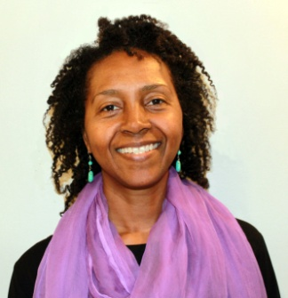
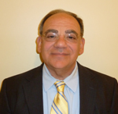
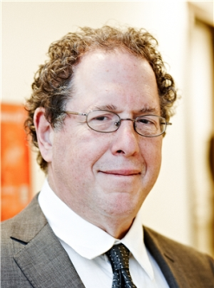
Get on track with your thyroid health!
New York Stem Cell Treatment Center
at Patients Medical
Research Team
Dr. Kamau Kokayi
Dr. L. Deanna Howard
Dr. Gino Bottino
Dr. Stuart Weg

Slide 79
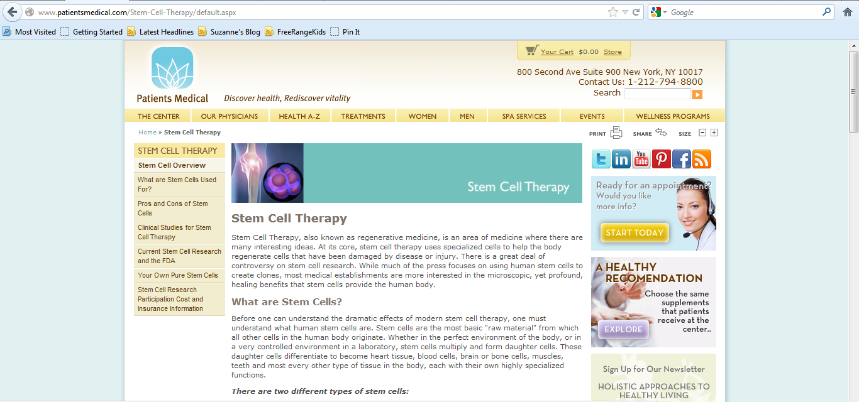
Check out our website!

Slide 80
Before you leave…
Please take a moment to ask us
any questions you may have.
Or, if you have questions after you leave, feel free to contact us by phone or email.
We appreciate your time.
Thank you for coming!

